Slide 1

FINANCIAL MANAGEMENT MGT 1029 REVIEW - 1
Submitted to :
Prof. Gopinathan N

Slide 2
TABLE OF CONTENTS
01
02
03
04
ABSTRACT
ANNUAL REPORT
FINANCIAL STATEMENT
BOARD OF DIRECTORS
05
06
AUDITOR’S REPORT
KEY PERFORMANCE INDICATORS
07
08
DIVI’S MARKET CAP
MARKET CAP GRAPH

Slide 3
ABSTRACT
ABSTRACT
Financial analysis is the process of evaluating businesses, projects, budgets, and other finance-related transactions to determine their performance and suitability. It is used to analyze whether an entity is stable, solvent, liquid, or profitable enough to warrant a monetary investment. The aim of this project is to determine and evaluate current financial condition of a company and predict its future performance in the market. In order to evaluate performance of the company annual report and auditor report along with financial statements are analyzed. For this project we have selected Divi's Laboratories Limited, which are engaged in manufacturing and sale of active pharmaceutical ingredients (APIs) and Intermediates. Few of its products include Generic APIs, Intermediates, Peptide Building Blocks and Carotenoids.

Slide 4

ANNUAL REPORT
An annual report is a financial document that a public company prepares for its shareholders. These reports are can be used by potential investors and securities analysts to evaluate a company’s stock.
Basic overview of what is contained in an annual report:
Chairman’s Letter
Business Profile
Management’s Analysis
Financial Statements

Slide 5

FINANCIAL STATEMENT
Financial statements are written records that convey the business activities and the financial performance of a company. Financial statements are often audited by government agencies, accountants, firms, etc. to ensure accuracy and for tax, financing, or investing purposes.
Financial statements include:
Balance sheet
Income statement
Cash flow statement.

Slide 6
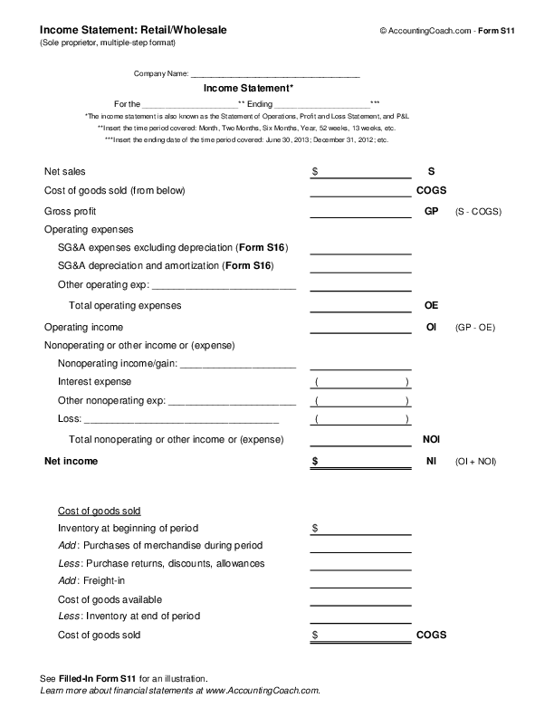
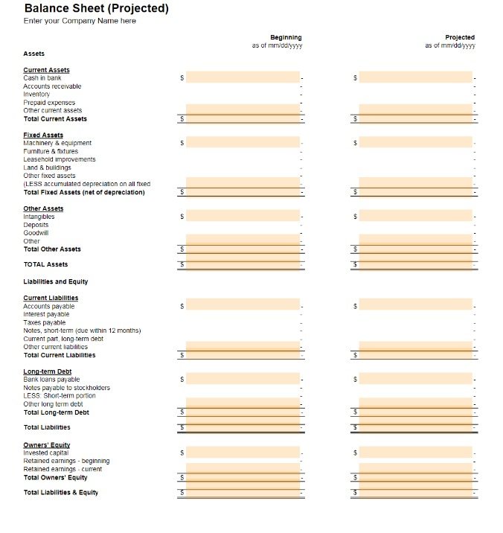

Slide 7
BOARD OF DIRECTORS
A board of directors (B of D) is an elected group of individuals that represent shareholders. The board is a governing body that typically meets at regular intervals to set corporate management and oversight policies.
Role of the Board of Directors:
Recruit, supervise, and evaluate the manager
Provide direction for the organization
Establish a policy based governance system
Govern the organization and the relationship with the CEO
Fiduciary duty to protect the organization’s assets and member’s investment
Monitor and control function

Slide 8
AUDITOR’S REPORT
An auditor's report is a written letter from the auditor containing their opinion on whether a company's financial statements comply with generally accepted accounting principles (GAAP) and are free from material misstatement.
The components of an Auditor’s Report:
The auditor's letter follows a standard format, as established by generally accepted auditing standards (GAAS). A report usually consists of three paragraphs.
The first paragraph states the responsibilities of the auditor and directors.
The second paragraph contains the scope, stating that a set of standard accounting practices was the guide.
The third paragraph contains the auditor's opinion.

Slide 9
SALES INDICATORS:
Revenue
Net profit
CASH FLOW INDICATORS:
Current ratio
Liquid ratio
FINANCIAL STATUS:
Total assets
Total liability
Total equity
BUSINESS INDICATORS:
Debt/Equity ratio
ROE
ROCE
ROA
EPS
DPR
Key performance indicators (KPIs) refer to a set of quantifiable measurements used to gauge a company’s overall long-term performance.
KPIs specifically help determine a company's strategic, financial, and operational achievements, especially compared to those of other businesses within the same sector.
Key Performance Indicators:

Slide 10
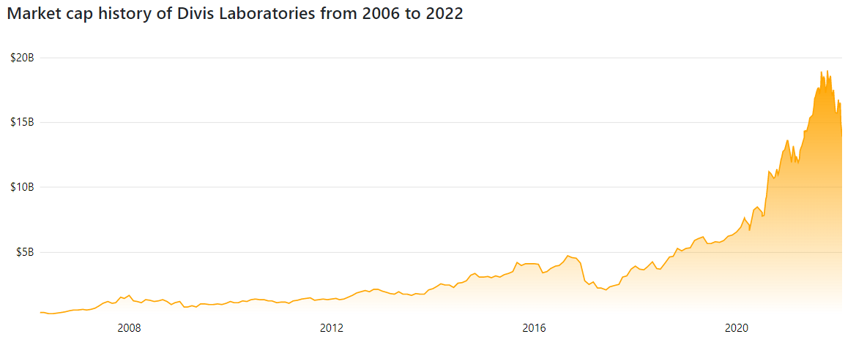
DIVI’S MARKET CAP

Slide 12

THANK YOU
Team Members Ajay Rajkumar 20BAI1020 Arnab Mondal 20BCE1394 Aryan Bansal 20BCE1591 Dharani R 20BCE1897 Govind Agarwal 20BCE1618 Kritika Jindal 20BCE1913

